Slide 1
Solid Roots
A Framework for Tier 3 Behavior Intervention

Slide 2
Behavior Support: Multi-Tiered Model
Tier 3
Intensive
Tier 2
Standardized
Tier 1
Universal
Solid Roots:
Intended for a small number of students with the most intensive behavior needs

Slide 3
Tier 3 Behavior Support Overview
Address behavioral needs (the roots) in order to grow and thrive.
Solid Roots provides an
INSTRUCTIONAL APPROACH to Behavior Support
Show Video: Solid Roots Core Features
& Medical Model

Slide 4
Introductions: Campus Behavioral Staff
Teachers:
Support Staff:

Slide 5
Purpose of Solid Roots Support
Support students in the most inclusive environment possible.
Proactively teach social- emotional-behavioral skills.
Model strategies and techniques in the classroom to ensure consistency.
Move students to independence, not reliant on outside behavior support/personnel.
Employ proactive strategies to ensure students are successful in the classroom environment, rather than relying on reactive responses to challenging behavior after it occurs.

Slide 6
Our Role
Acknowledge
Desired Behaviors
“Keep the demand” – Make sure student finish what they start, despite the behavior that occurs
Correct Challenging Behaviors
Consult with teachers on strategies and techniques
Pre-teach social skills
Reinforce the use of pro-social behaviors during the class day
Respond to crisis , if needed
Ensure students stay in the learning environment by “pushing-in “
Structure the environment to encourage successful use of skills
Acknowledging the use of appropriate behaviors provides teaching and feedback to students to improve future behavior.

Slide 7
Solid Roots
Feedback with DBRC
Check-In
Feedback Loop
Monitor and Prompt
Check-Out
Social Skills
Daily Intervention
Cycle
* Show Video: Solid Roots Daily Routine

Slide 8
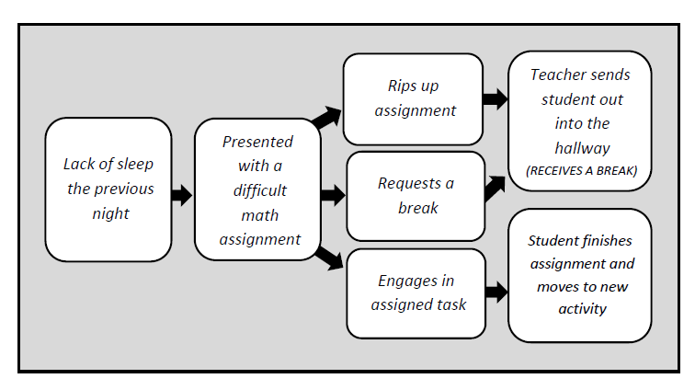
The Competing Behavior Pathway
The purpose of the Solid Roots interventions is to move students along the pathway from challenging behaviors to more desired/goal behaviors

Slide 9
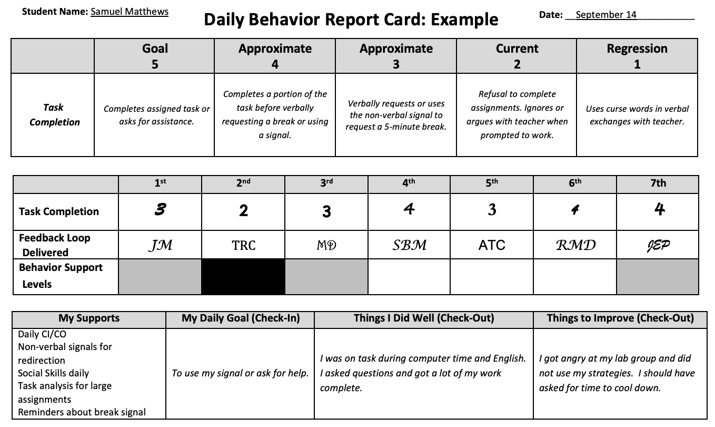
Feedback with DBRC
No additional notes are needed.
Scale describes student behavior.
Teacher fills in rating based on student performance and initials to indicate they provided feedback.
Bottom boxes are used with mentor in check-in and check-out.
Notes:
No additional notes from the teacher are needed. If the classroom teacher needs to communicate with Solid Roots team, either communicate in person or via email. The DBRC is for the student to use as an intervention tool.

Slide 10
Purpose of the Feedback Loop
Feedback
IS
the Intervention!
Script | Today I saw/heard you ________ (acknowledge a desired behavior) I also noticed _______ (address challenging behavior) Tomorrow/Next time please remember to ___________ (prompt replacement behavior) Hope the rest of the day goes smoothly (launch positively)
* Show Video: DBRC Feedback Loop

Slide 11
Purpose of Check-In
Build relationships & check for setting events
Support goal-setting
Practice strategies & coping skills
Logistics

Slide 12
Purpose of Check-Out
Guided self-reflection
Goal review- consider modifications or adjustments for future success.
Build relationships
Logistics

Slide 13
Purpose of Social Skills
Direct instruction in areas of need.
Practice strategies to support application in other environments.
Use high-yield instructional strategies.
Logistics:

Slide 14
Purpose of Monitor and Prompt
Acknowledge students who are demonstrating skills.
Prompt strategies when students are struggling (replacement behaviors).
Model behavior interventions for classroom teachers.
Support & guide de-escalation when needed.
Logistics
* Show Video: Monitor & Prompt, Restorative Chat

Slide 15
Classroom Teacher Role
Build positive relationships with students
Know & implement student interventions
Ask questions when unclear or needing support
Communicate with us PRIOR to crisis
Crisis: Violent behavior, physical aggression, extreme disruptions
Crisis Procedures: (fill in as appropriate)

Slide 16
Communication from Our Team
Request for feedback emails
Stay in communication about student progress and student needs
Every three-weeks
DBRC student form
Progress-monitoring behavior goals
Daily
Intervention paperwork
(Sped, 504, RtI)
Inform required interventions, accommodations and modifications

Slide 17
Frequently Asked Questions
How do I know if Solid Roots staff will be supporting a student in my classroom?
What do I do if a student begins to display challenging behavior in my class?
When are Solid Roots staff available to answer questions or conference regarding student needs or interventions?

